Slide 1
CS/IT 323
Interactive Computer Graphics
Introduction and Overview
TEXT BOOK :
"Computer Graphics C version“, Donald Hearn and M Pauline Baker, Pearson Education 2nd Edition.

Slide 2
Course Objectives:
Describe the functions and operations of display hardware and associated devices.
To study algorithms for drawing 2D primitives.
Describe and implement geometric transformations of 2D & 3D objects.
Understand that the simple animation process can be applied on output primitives.

Slide 3
Course Outcomes:
Ability to understand the functions and operations of display hardware and associated devices.
Design of data structures to the management of computer graphics entities.
Ability to draw lines, circles, ellipses and polygon shapes.
Ability to design 2D & 3D transformations.
Ability to develop simple graphics animation applications.

Slide 4
Prerequisites:
Knowledge of the following mathematical topics
Vectors, vector operations, and vector spaces
Matrices
Basic linear algebra such as solving a system of linear equations
Polynomials
Data structures and Algorithms

Slide 5
What is Computer Graphics?
• The creation of, manipulation of, analysis of, and interaction with pictorial representations of objects and data using computers.
- Dictionary of Computing
Creation, Manipulation and Storage of geometric objects (modelling) & their images (rendering).
• Computer Graphics (another definition)
- Application of computers to the disciplines of
sciences/engineering

Slide 6
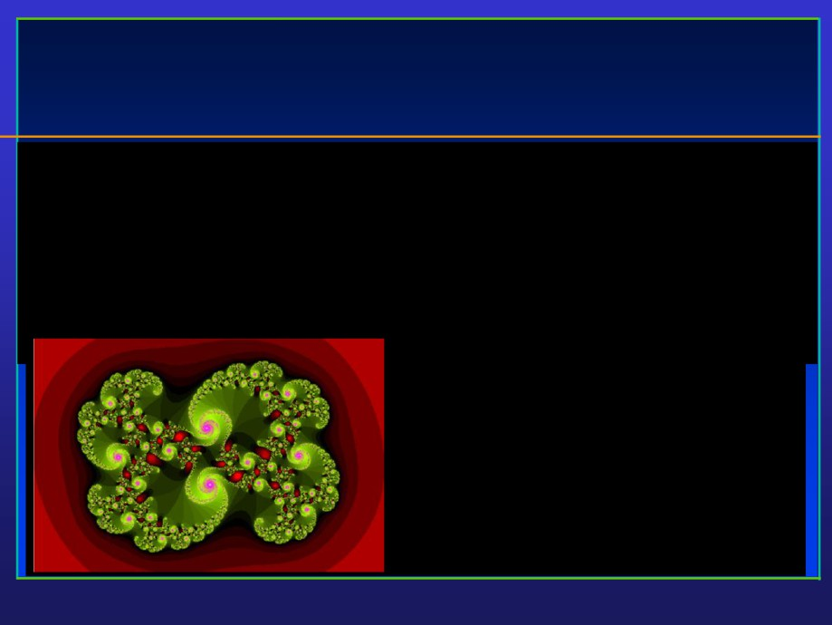
• A picture is worth a thousand words.
- Chinese Proverb
It looks like a swirl. There are smaller swirls at the edges.
1000 words (or just 94 words), many letters though…
It has different shades of red at the outside, and is mostly green at the inside. The smaller swirls have purple highlights. The green has also different shades. Each small swirl is composed of even smaller ones. The swirls go clockwise. Inside the object, there are also red highlights. Those have different shades of red also. The green shades vary in a fan, while the purple ones are more uni-color. The green shades get darker towards the outside of the fan …

Slide 7

Computer Graphics Definition
• What is Computer Graphics?
- (Realistic) Pictorial synthesis of real and/or imaginary objects from their
computer-based models (or datasets)
• Fundamental, core elements of computer graphics
- Modeling: representation choices, geometric processing
- Rendering: geometric transformation, visibility, simulation of light
- Interaction: input/output devices, tools
- Animation: lifelike characters, natural phenomena, their interactions, surrounding environments
• So, we are focusing on computer graphics hardware, software, and mathematical foundations
• Computer Graphics is computation
- A new method of visual computing
• Why is Computer Graphics useful and important?

Slide 8

Why Computer Graphics?
• About 50% of the brain neurons are associated with vision
• Dominant form of computer output
• Enable scientists (also engineers, physicians, and general users) to observe their simulation and computation
• Enable them to describe, explore, and summarize their datasets (models) and gain insights
• Enrich the discovery process and facilitate new
inventions

Slide 9

Why Computer Graphics?
• Applications (In essence, computer graphics is application-driven)
- Entertainment: Movies, Video games
- Graphical user interface (GUI)
- Computer aided design and manufacturing (CAD/CAM)
- Engineering analysis and business
- Medical applications
- Computer Art
- Engineering Analysis
- Scientific visualization / simulation
- Virtual Reality
- others

Slide 10
So Computer Graphics routinely used in diverse areas as Science,
Engineering,
Medicine,
Business,
Industry,
Government,
Art,
Entertainment,
Advertising,
Education and
Training

Slide 11
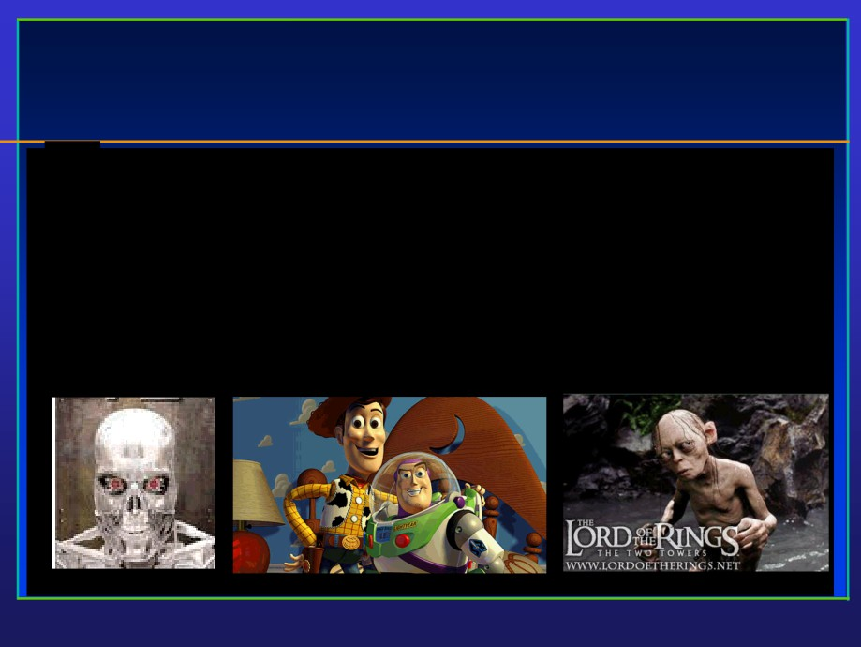
Entertainment

Slide 12
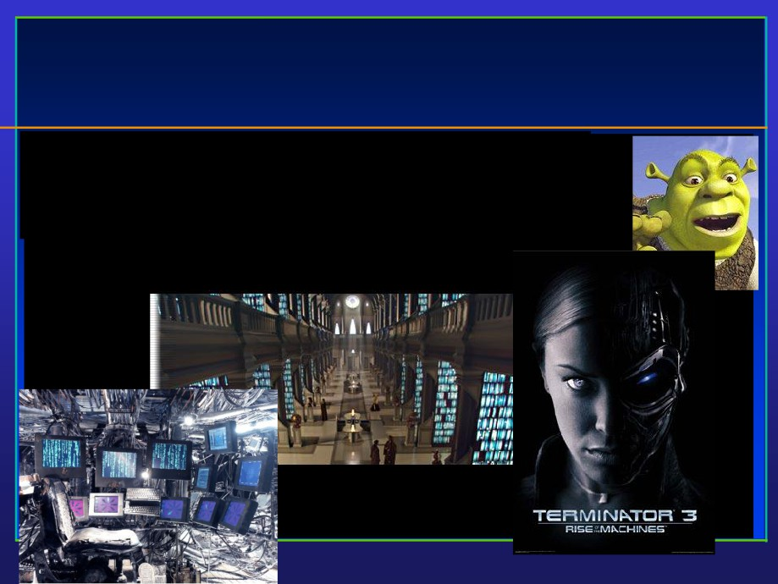
Movies
• If you can image it, it can be done with computer graphics!
• More than one billion dollars on special effects.
• No end in sight for this trend!

Slide 13
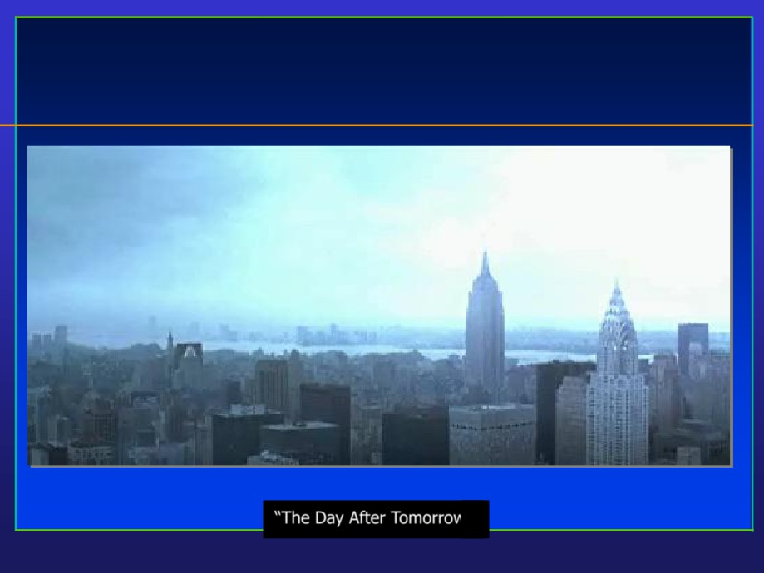
Movies
“The Day After Tomorrow”

Slide 14
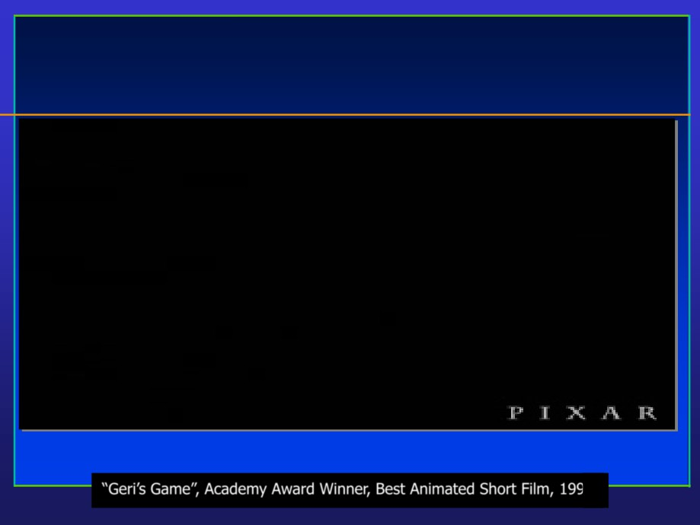
Movies

Slide 15
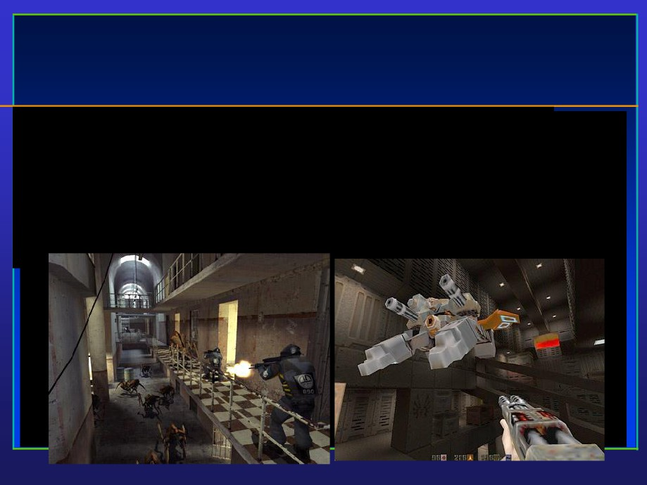
Video Games
• Important driving force
• Focus on interactivity
• Try to avoid computation and use various tricks

Slide 16
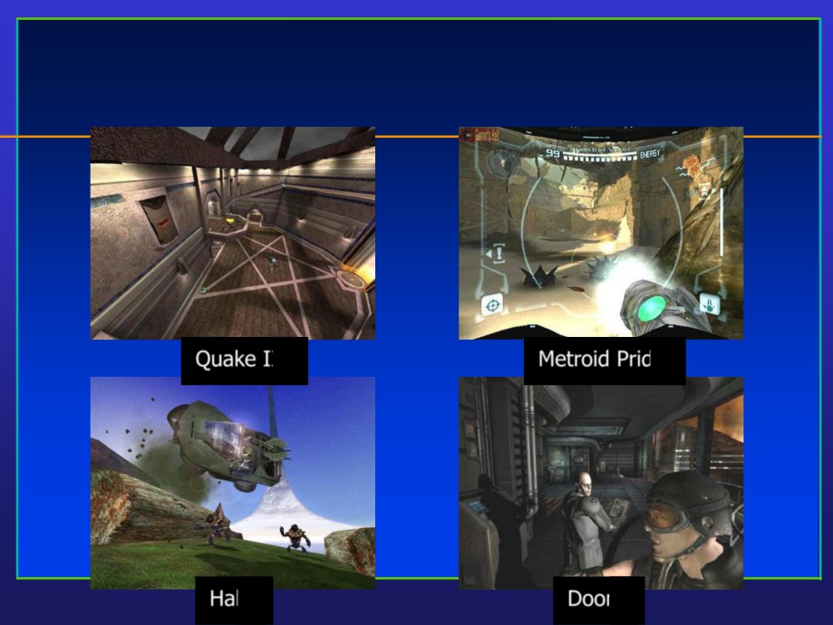
Games
Quake III
Metroid Pride
Halo
Doom

Slide 17
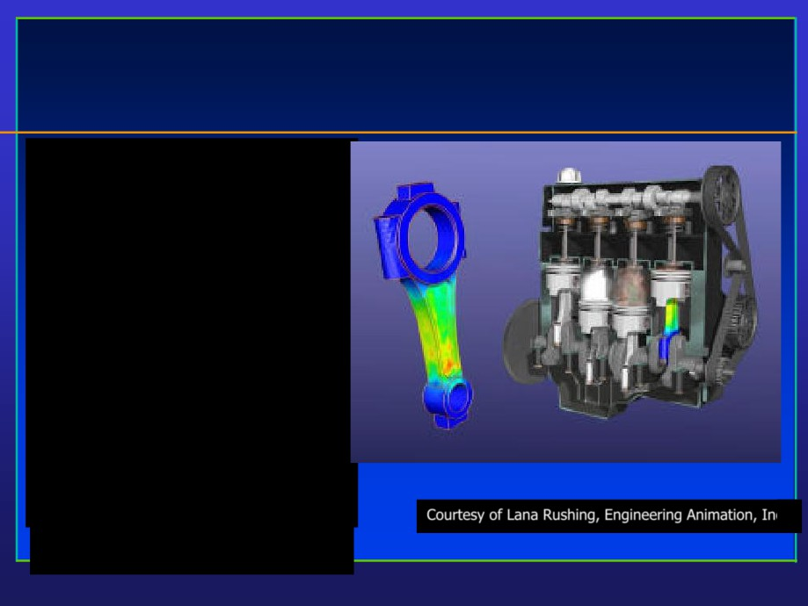
Engineering Design
• Engineering & Architecture
Software
• Buildings, aircraft,
automobile, computers, appliances, etc.
• Interactive design (mesh
editing, wire-frame display, etc.)
• Standard shape database
• Design of structural
component through numerical simulation of the physical operating environment
• Testing: real-time animations
Courtesy of Lana Rushing, Engineering Animation, Inc.

Slide 18
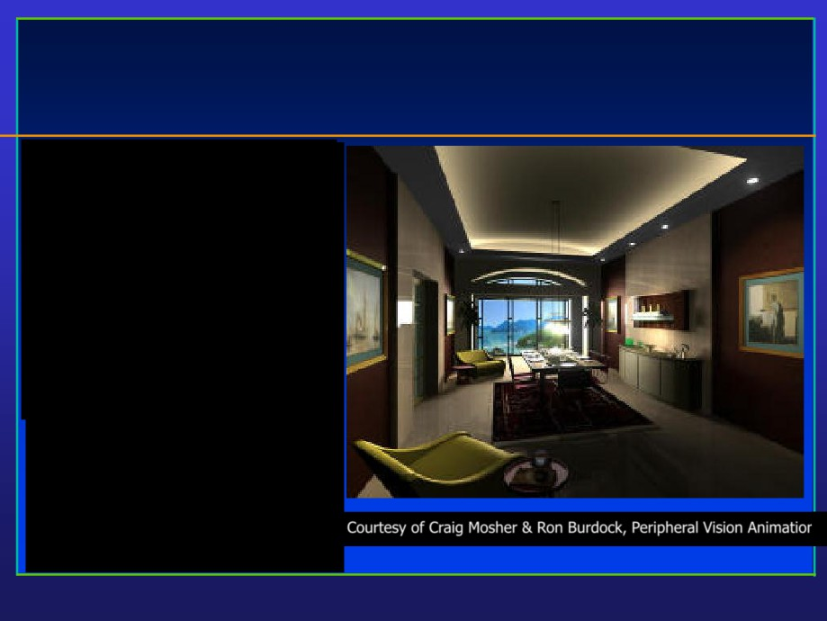
Architectural Design
• Architecture, Engineering,
Construction
• Final product appearance:
surface rendering, realistic
lighting
• Construction planning:
architects, clients can study appearance before actual construction
Courtesy of Craig Mosher & Ron Burdock, Peripheral Vision Animations

Slide 19
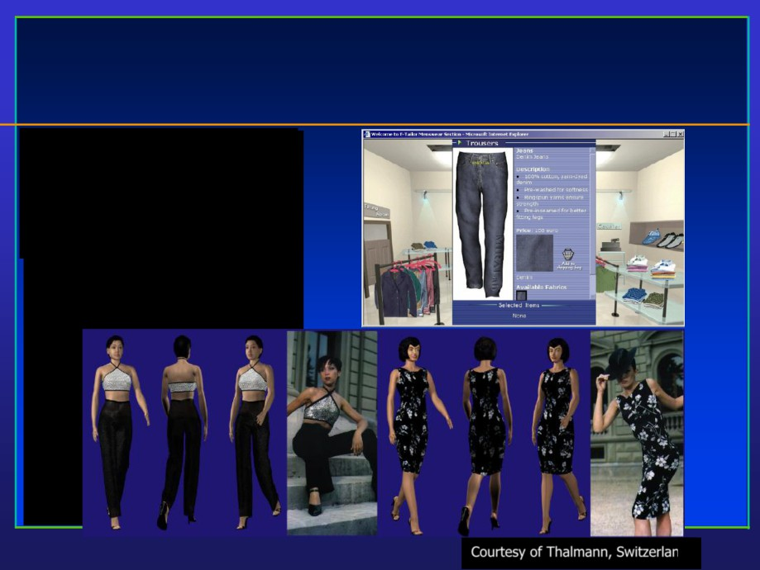
Textile Industry
• Fashion design
• Real-time cloth animation
• Web-based virtual try-on
applications
Courtesy of Thalmann, Switzerland

Slide 20
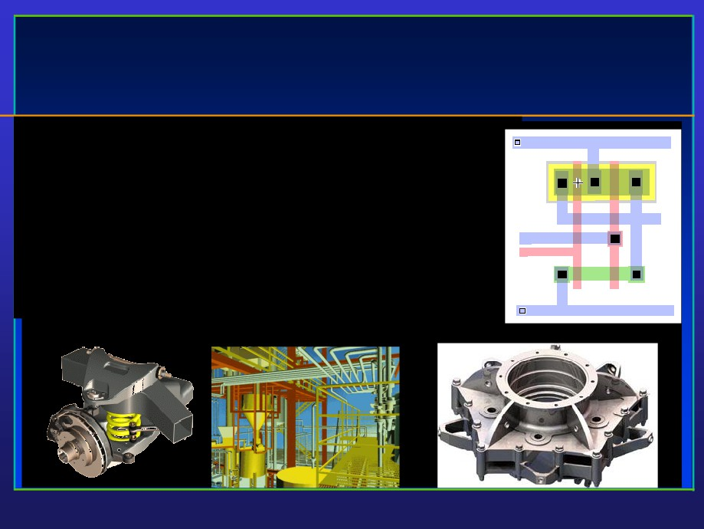
Computer-Aided Design
• Significant impact on the design process
• Mechanical, electronic design
- entirely on computer
• Architectural and product design
- Migrate to the computer
towards virtual manufacturing

Slide 21

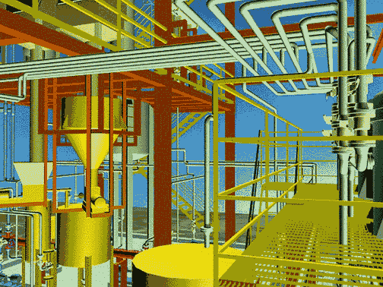
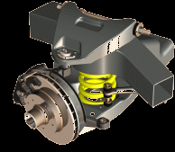
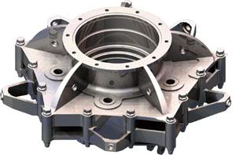
Computer-Aided Design (CAD)
Significant impact on the design process
•Mechanical, electronic design
–entirely on computer
•Architectural and product design
–Migrate to the computer
Used in design of buildings, automobiles, aircraft, watercraft, spacecraft, computers, textiles & many other products
Objects are displayed in wire frame outline form
Software packages provide multi-window environment
UGS: towards virtual manufacturing

Slide 22
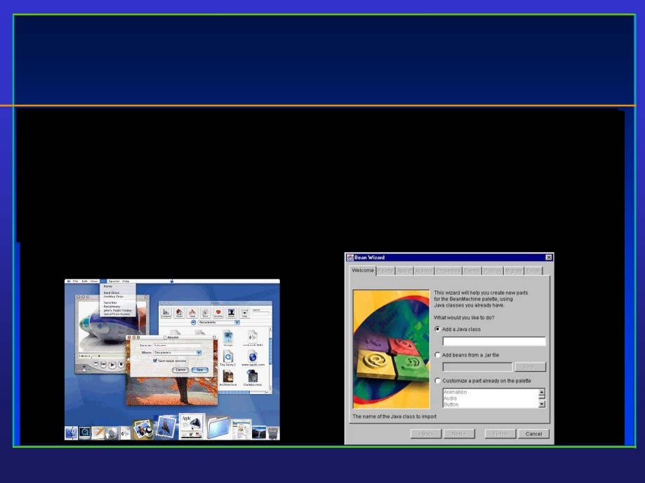
Graphical User Interface: GUI
• Integral part of everyday computing
• Graphical elements everywhere
- Windows, cursors, menus, icons, etc
• Nearly all professional programmers must have an understanding
of graphics in order to accept input and present output to users.

Slide 23
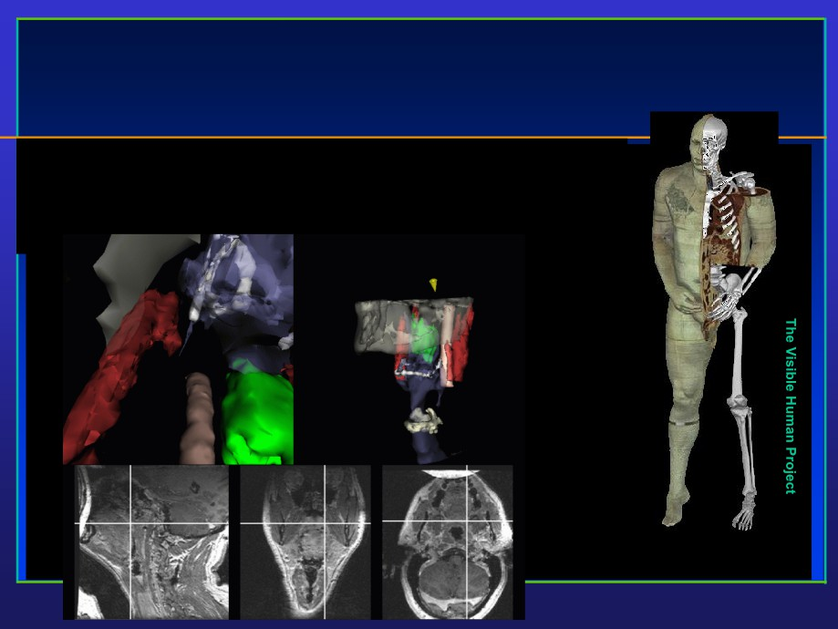
Medical Applications
• Significant role in saving lives
• Training, education, diagnosis, treatment
Creation of complete,
anatomically detailed 3D
representation of human bodies.

Slide 24
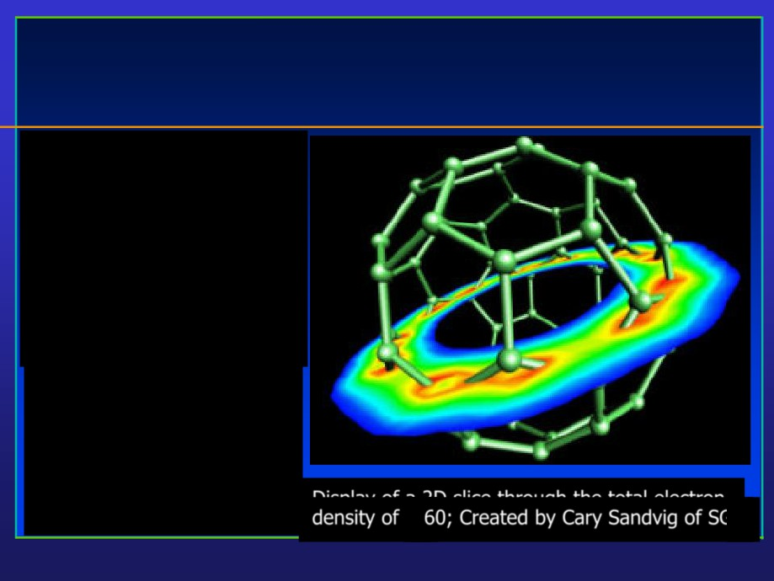
Scientific Visualization
• Scientific data
representation
• Picture vs. stream of
numbers
• Techniques: contour plots, color coding, constant
value surface rendering, custom shapes
Display of a 2D slice through the total electron density of C-60; Created by Cary Sandvig of SGI

Slide 25
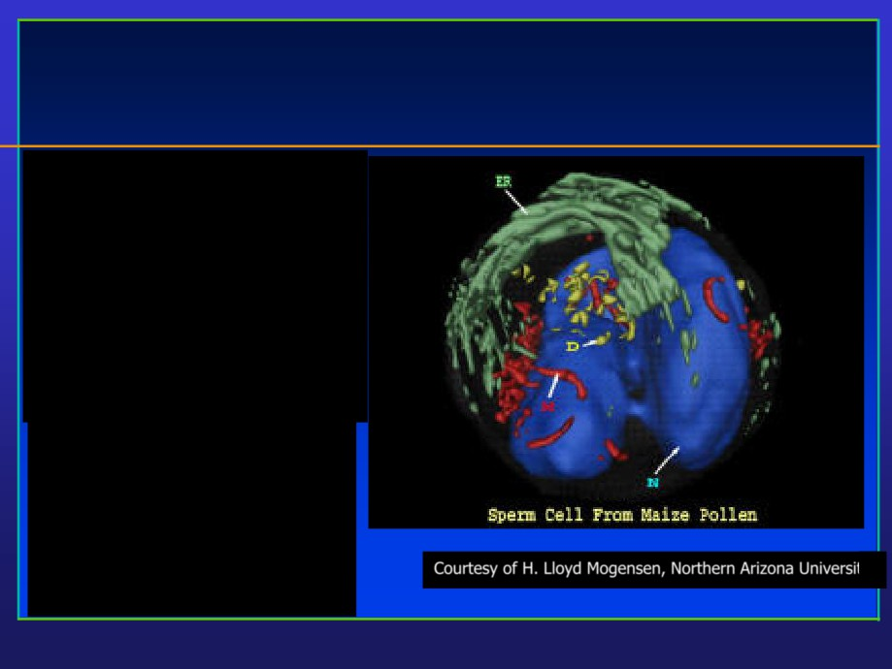
Scientific Visualization
• Life Sciences
• Providing quantitative,
three dimensional electron
microscopy.
• Scientists can see structures as they were before being sectioned for viewing in the electron microscope.
Courtesy of H. Lloyd Mogensen, Northern Arizona University

Slide 26
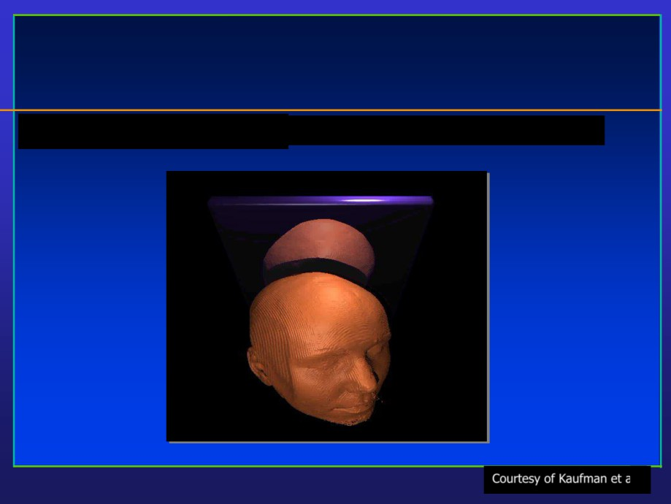
Scientific Visualization
• Medical imaging & visualization
Courtesy of Kaufman et al.

Slide 27
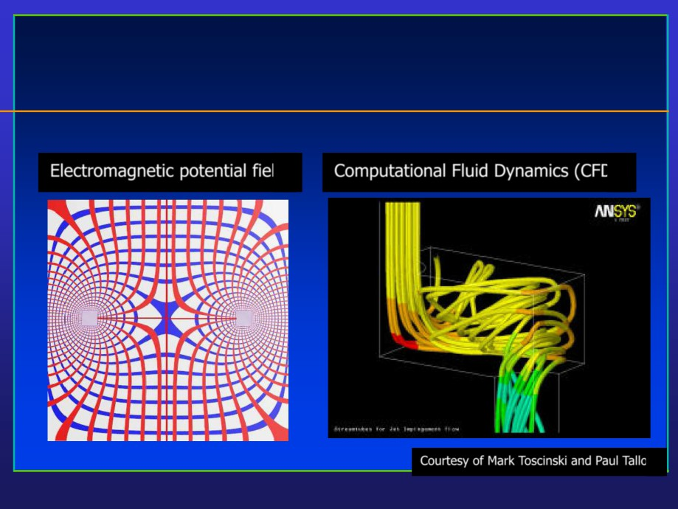
Scientific Visualization / Simulation
Electromagnetic potential field Computational Fluid Dynamics (CFD)
Courtesy of Mark Toscinski and Paul Tallon

Slide 28
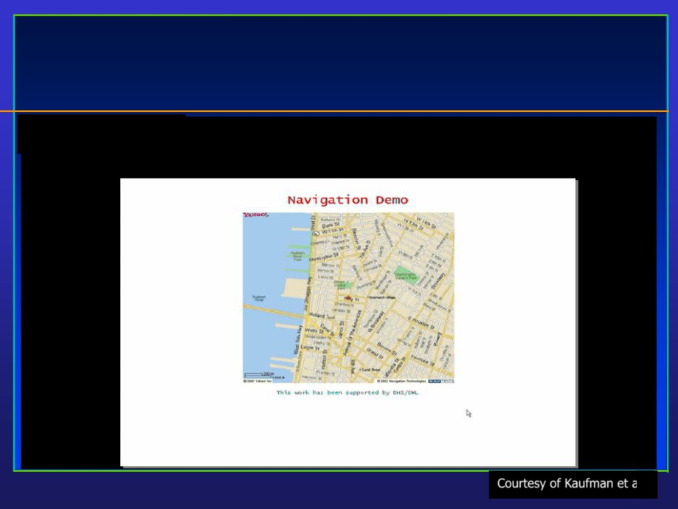
Scientific Visualization / Simulation
• Urban security
Courtesy of Kaufman et al.

Slide 29
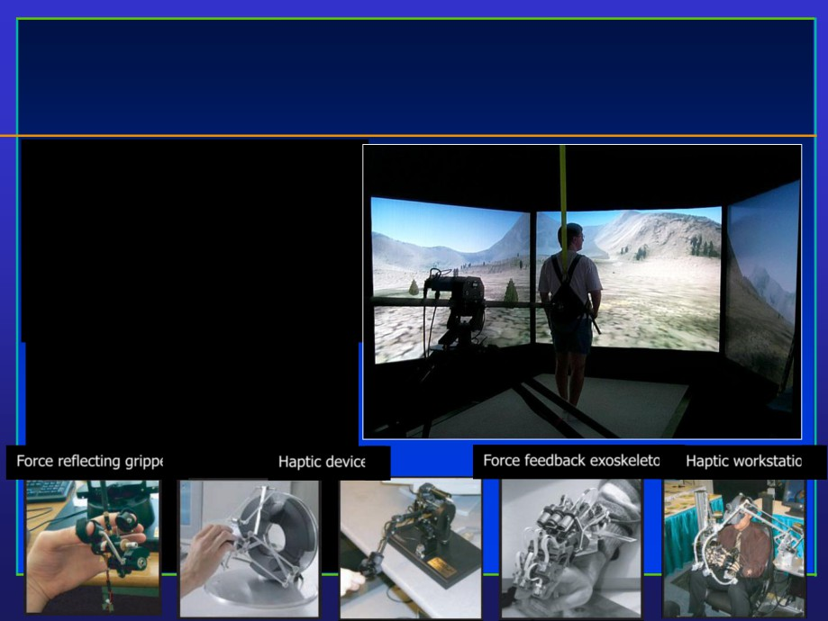
Virtual Reality
• User interacts with objects in a 3D scene
• Special devices (input, output)
• Virtual walkthroughs
• Equipment training (pilots, surgeons, etc.)
Force reflecting gripper
Haptic devices
Force feedback exoskeleton Haptic workstation
D
8
K

Slide 30
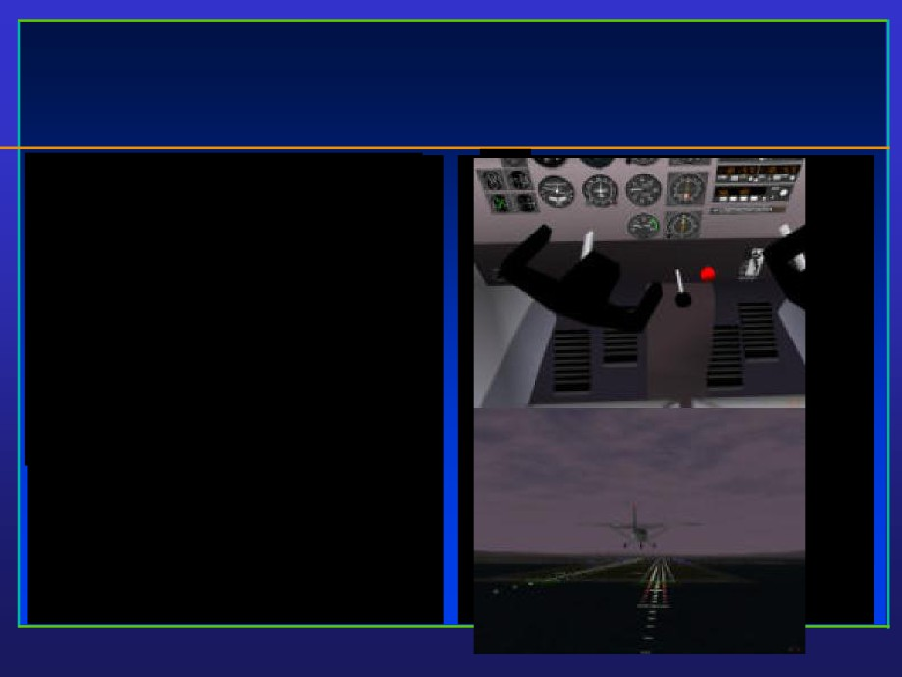
Virtual Reality
• Education using computer-generated
system &
process models
• Visual simulation:
- Aircraft simulator
- Spacecraft simulator
- Naval craft simulator
- Automobile simulator
- Heavy machinery simulator
- Surgery simulator
• Special hardware required
S

Slide 31
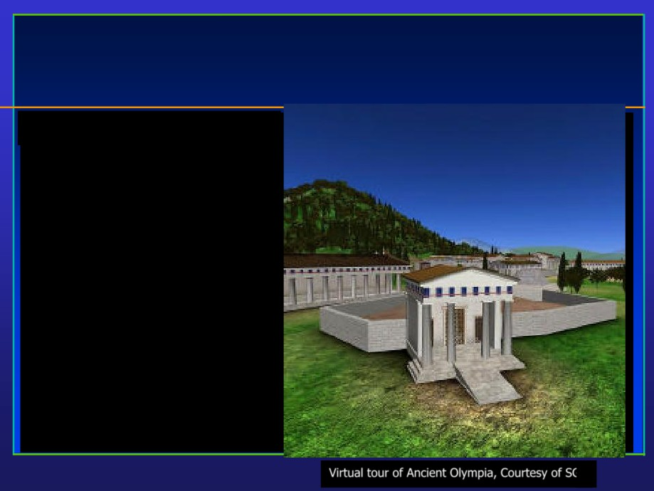
Virtual Reality
• Virtual tour of historical remains
Virtual tour of Ancient Olympia, Courtesy of SGI

Slide 32
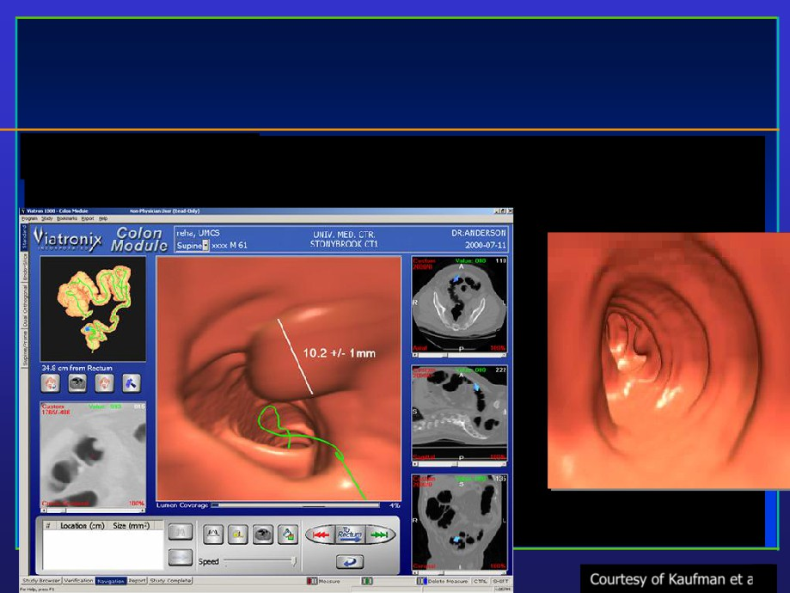
Virtual Reality
• Virtual colonoscopy
Courtesy of Kaufman et al.

Slide 33
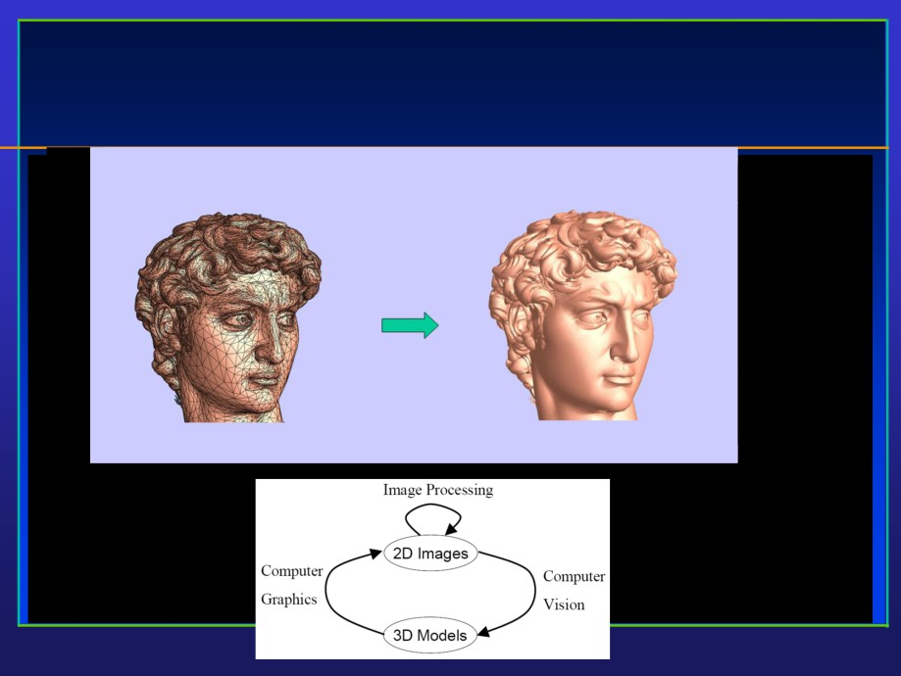
Image Processing, Analysis, and Synthesis

Slide 34
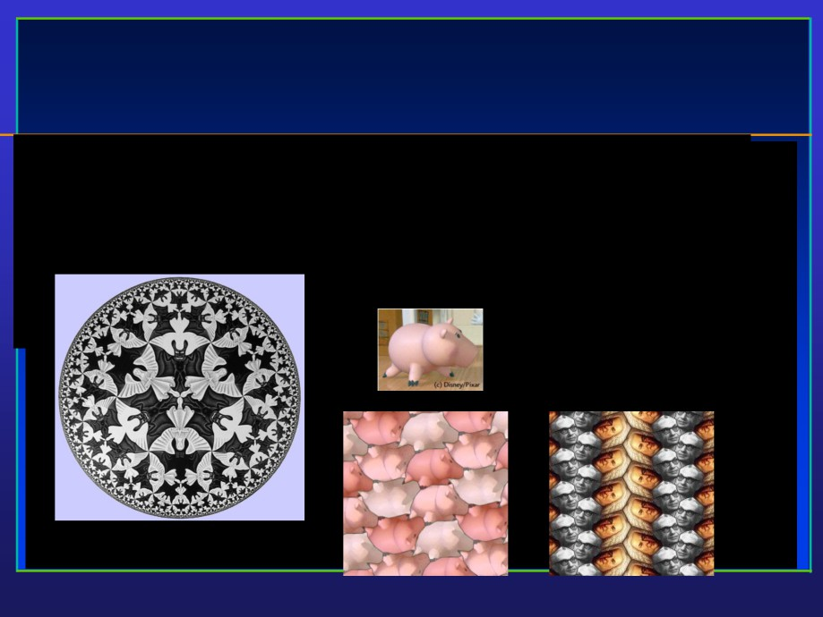
Computer Art
• Escher Drawing
- Combine interlocking shapes with tessellation to
convey the beauty in structure and infinity
Image courtesy of Escher

Slide 35
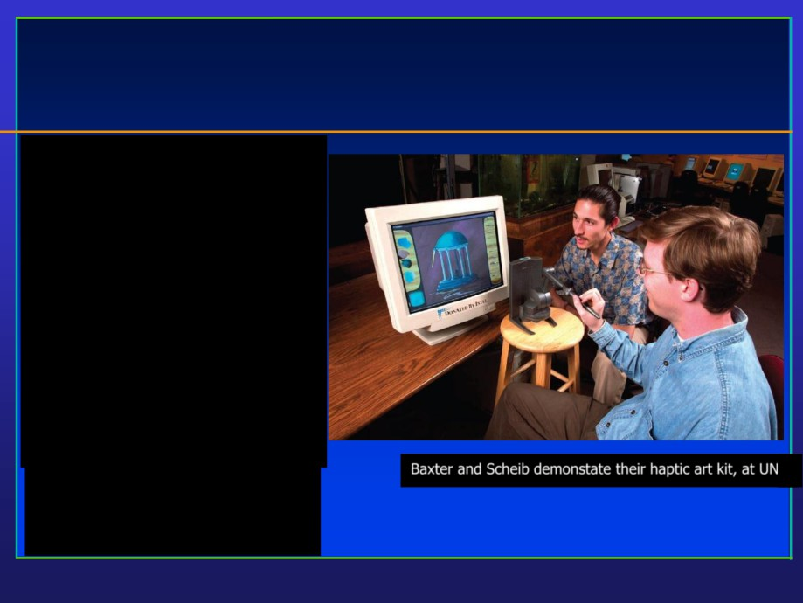
Computer Art
• Fine arts, commercial art
• Artistic tools for digital art:
- Mathematical software
(Matlab, Mathematica)
- CAD software
- Sculpting, painting, calligraphy systems
• Graphical user interfaces
• Special input devices
(pressure-sensitive stylus, graphical tablet, etc.)
Baxter and Scheib demonstate their haptic art kit, at UNC

Slide 36
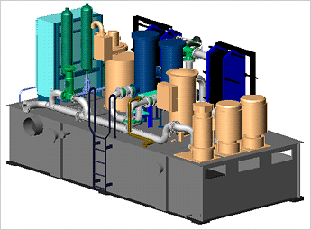
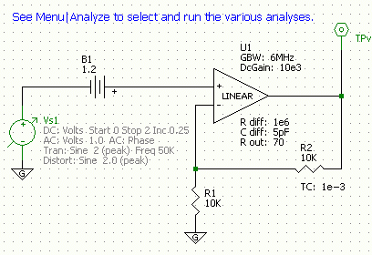
CG: a core technology in CAD
AutoCADTM
5SpiceTM

Slide 37

Movies
expression
depth of field
fracture
motion
water
hair
H&B 1:2-32
reflection

Slide 38
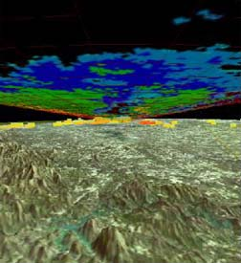
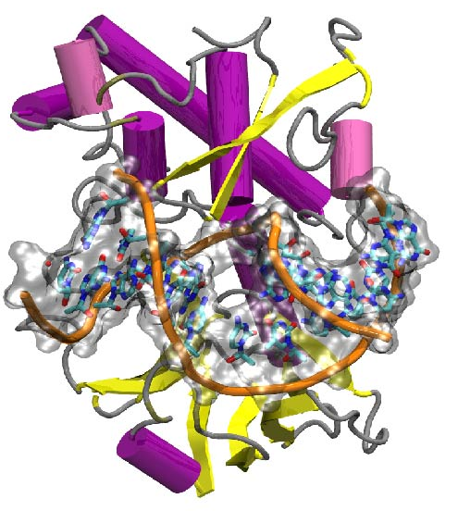
CG: a core technology in Scientific Visualization
Molecular Vis.
Weather

Slide 39
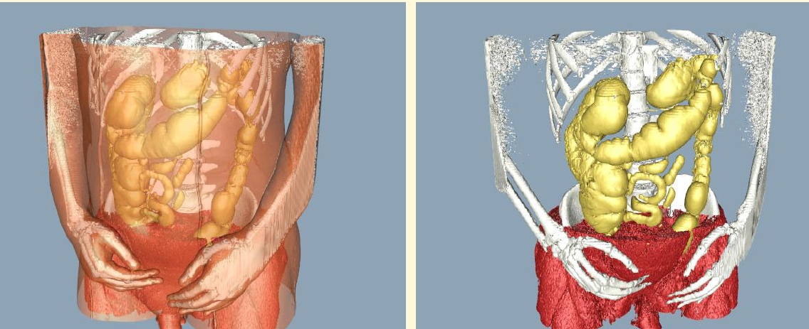
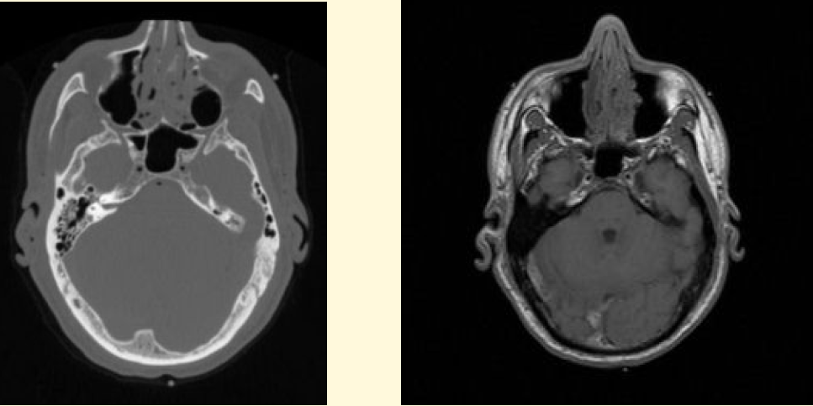
CG: a core technology in Medical Visualization

Slide 40
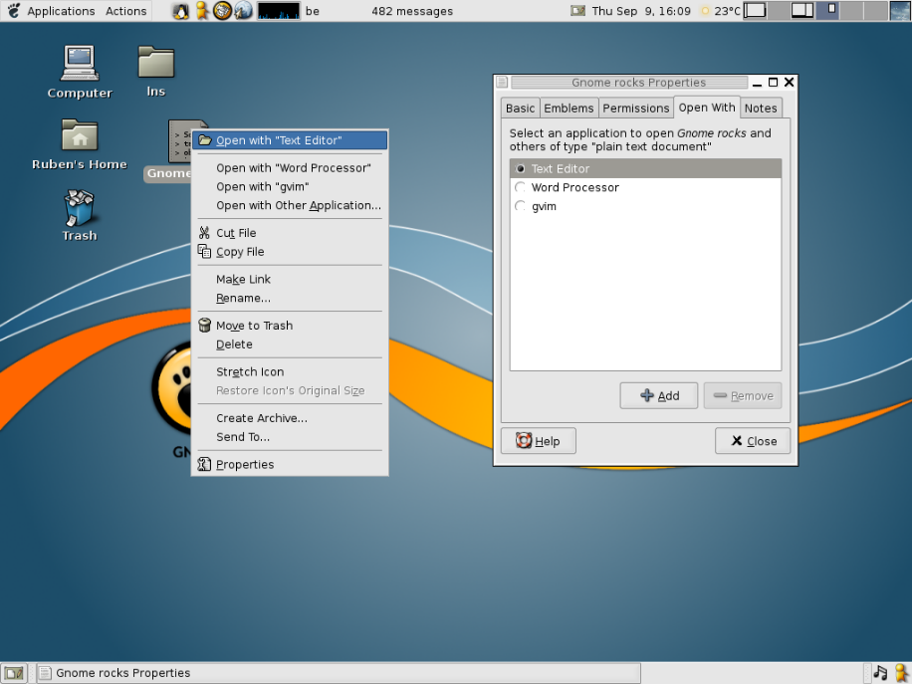
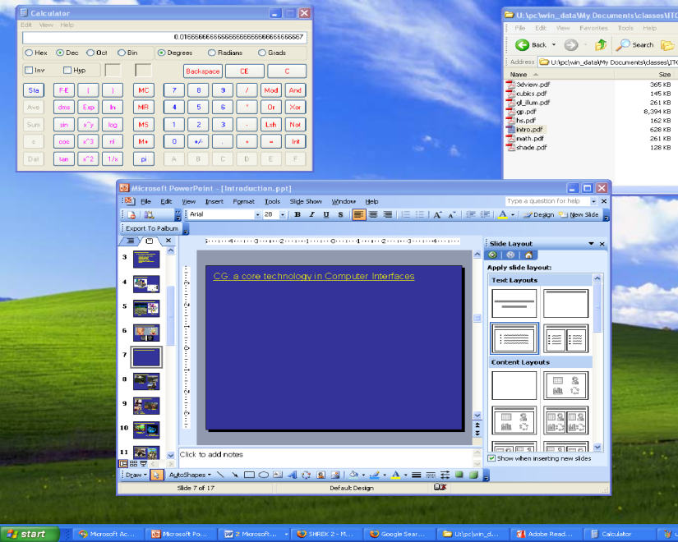
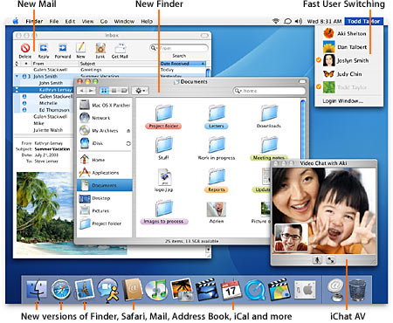
CG: a core technology in Computer Interfaces
GNOME
Microsoft Windows
Mac OS X

Slide 41
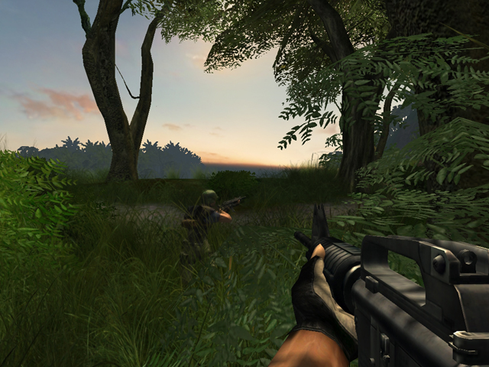
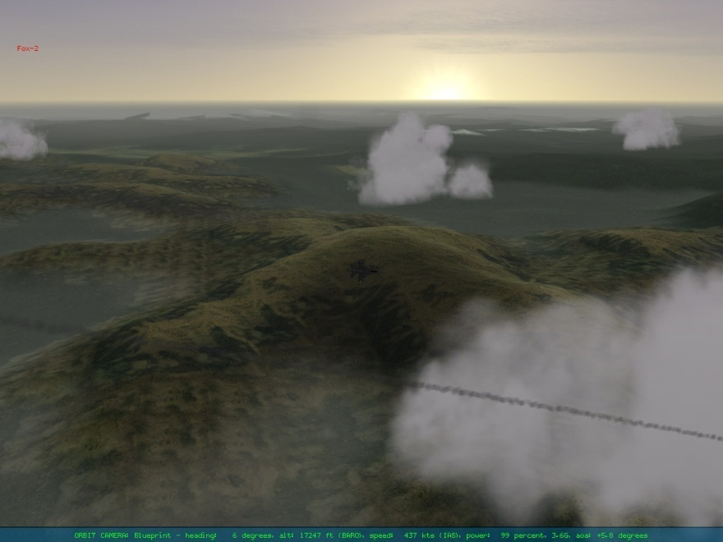
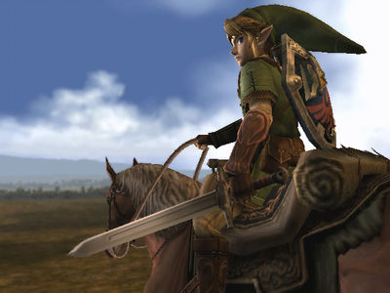
CG: a core technology in Games
Falcon 4.0(Microprose)
FarCry (UbiSoft)
Zelda (Nitendo)

Slide 42
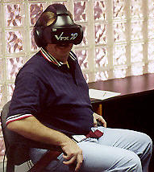
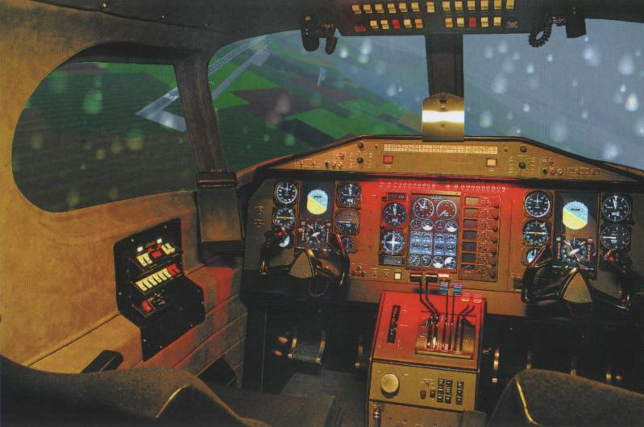
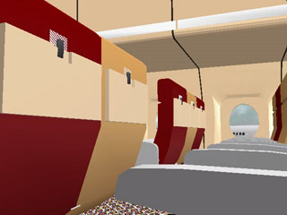
CG: a core technology in VR & Vis. Sim.
Pilot Training(AlSim, Inc.)
Exposure Therapy
for Flying Phobia(Larry Hodges et.al)

Slide 43
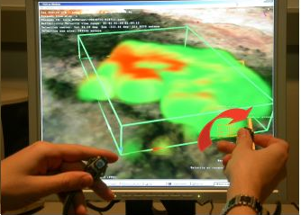
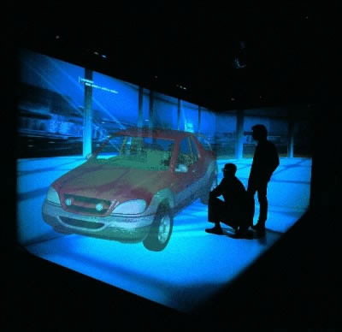
CG: a core technology in VR & Vis. Simulation
Two-hand Interface
for Weather Vis.
“Holospace”
Surround ScreenDisplay(Barco)

Slide 44

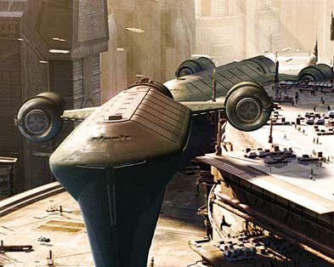
CG: a core technology in Movies
Star Wars: Episode IITM(LucusFilm)
Shrek 2TM(Dreamworks)

Slide 45
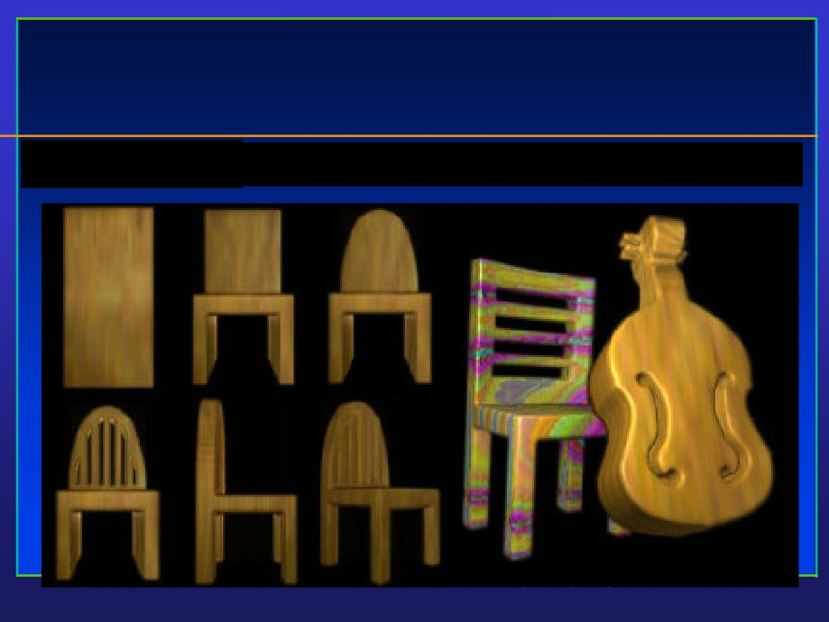
Computer Art
• Digital Sculpting

Slide 46
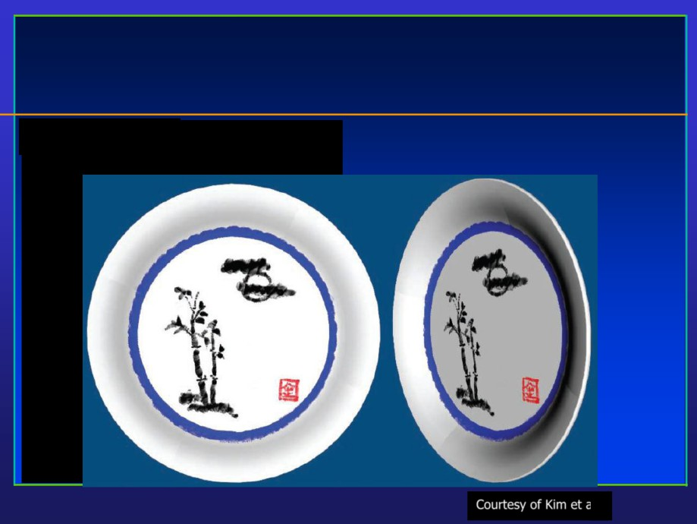
Computer Art
• Digital Painting
Courtesy of Kim et al.

Slide 47
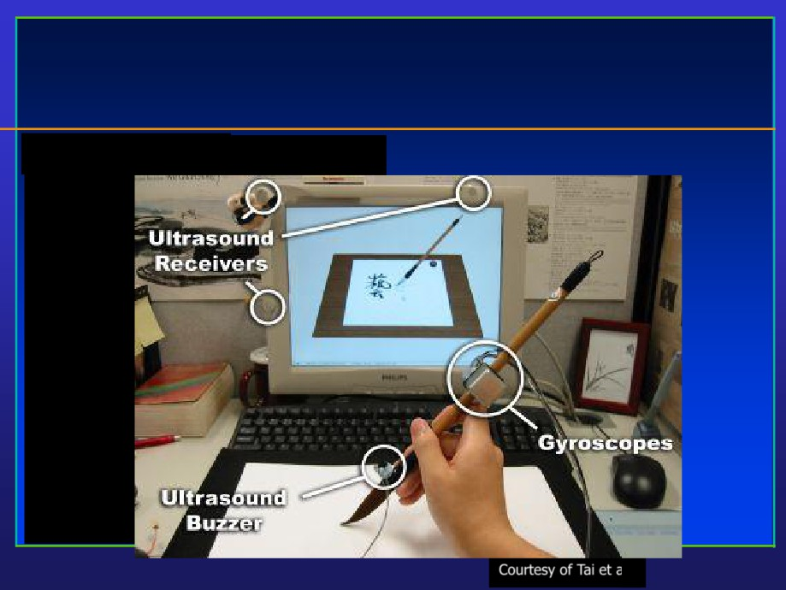
Computer Art
• Digital Calligraphy
Courtesy of Tai et al.

Slide 48
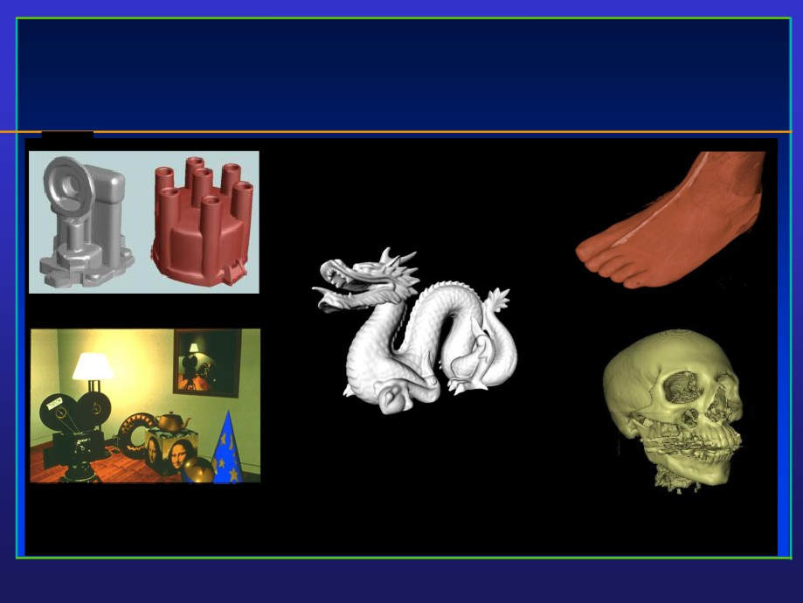
Graphics Examples

Slide 49

Why Visualization
Visualization is a method of extracting meaningful information from complex or voluminous datasets through the use of interactive graphics and imaging

Slide 50


Slide 51

Why Visualization
• Enable scientists (also engineers, physicians, general users) to observe their simulation and
computation
• Enable them to describe, explore, and summarize their datasets (models) and gain insights
• Offer a method of SEEING the UNSEEN
• Reason about quantitative information
• Enrich the discovery process and facilitate new
inventions

Slide 52

Why Visualization
• Analyze and communicate information
• Revolutionize the way scientists/engineers/physicians
conduct research and advance technologies
• About 50% of the brain neurons are associated with vision
• The gigabit bandwidth of human eye/visual system permits much faster perception of visual information and identify their spatial relationships than any other
modes
- Computerized human face recognition

Slide 53

Graphics Examples: Representation
Points
Images
Volumes

Slide 54

More Examples
• Medical Imaging, geometry processing, physical simulation

Slide 55

Terrain Modeling and Rendering

Slide 56

Medicine and Health-care

Slide 57

Virtual Environment

Slide 58

National Security

Slide 59

Network Graphics
3D Advertisement
Server Virtual Museum
Client
Live Sports Broadcast

Slide 60

Wireless Graphics

Slide 61

Case Studies:Simulation of Bubble Flow

Slide 62

Geometry Synthesis of Human Hair

Slide 63

Tree Simulation

Slide 64

Facial Expression Acquisition and Synthesis

Slide 65

Non-Photorealistic Rendering
S

Slide 66

Collision Handling

Slide 67

Shape Deformation

Slide 68

Shape Matching

Slide 69

Urban Modeling

Slide 70

Architectural Geometry

Slide 71

Biomechanical Modeling of Human

Slide 72

Impossible Figures

Slide 73

Computer Art

Slide 74

Light Transport

Slide 75

Model Segmentation

Slide 76

Building Reconstruction

Slide 77

Geometry Texture Synthesis

Slide 78

Generating New Models from Examples

Slide 79

Augmented Reality in Neurosurgery

Slide 80

Prerequisites: Basic Requirements
• Computer science
- Programming language: C/C++, Java, …
- Data structure: array, list, queue, …
• Mathematics
- Linear algebra: scalar, vector, matrix, dot product, cross product, …
- Calculus: derivatives, function plot, curves, surfaces,
- Geometry: Euclidean geometry, analytic geometry
• Computer graphics has a strong 2D/3D geometry
component!

Slide 81

Mathematical Background
• Computer graphics has a strong 2D/3D geometry component
• Basic linear algebra is also helpful - matrices, vectors, dot products, cross products, etc.
• More continuous math (vs. discrete math) than in typical computer science courses
• Function plots, curves, and surfaces
• Advanced math/physics for research:
- Modeling: Differential Geometry - curves, surfaces, solids
- Animation: Computational Solid Mechanics, Fluid Dynamics
- Rendering: Optics
-
…

Slide 82

Different Perspectives
• Application-oriented
- Motivation, driven by real problems
- E.g. scientific visualization, simulation, animation, virtual reality, computer-aided design, …
• Mathematics-oriented
- Mathematical elements
- E.g. computational geometry, differential geometry, PDEs, …
• Programming-oriented
- Modeling and rendering primitives: triangle mesh, point clouds, splines, …
- Basic procedural routines: edge flip, edge collapse, subdivision routines, …
• System-oriented
- Architecture, hardware, and software components
- E.g. workstation, cluster, GPU, …

Slide 83

What’s computer graphics course all about?
Not!
Paint and Imaging packages (Adobe Photoshop) Cad packages (AutoCAD)
Rendering packages (Lightscape)
Modelling packages (3D Studio MAX) Animation packages (Digimation)

Slide 84
What’s computer graphics all about?
•Graphics programming and algorithms
•OpenGL, Glut, rendering …
•Graphics data structures
• polygonal mesh, half-edge structure…
•Applied geometry, modeling
•Curve, surfaces, transformation, projection…
Well, it is a Computer Science course!

Slide 85

Presentation Outline
• 3D graphics pipeline

Slide 86

Basic Elements of Computer Graphics
• Graphics modeling: representation choices
• Graphics rendering: geometric
transformation, visibility, discretization,
simulation of light, etc.
• Graphics interaction: input/output devices, tools
• Animation: lifelike characters, their
interactions, surrounding environments

Slide 87

Two Approaches
• Don’t care the time/costs, want results
- Special effects, Movie
• Don’t care results, want real-time cheap
- Games, Virtual Reality
• Recently: a lot of convergence
- Movie quality games

Slide 88

Two Basic Questions
• What to render?
- Scene representation
- Modeling techniques
- Animation, simulation
- ...
• How to put it on the screen?
- Projection
- Visibility
- Illumination and shading
-
…

Slide 89

Basic Topics - Undergraduate
• Hardware, system architecture
- Basic display devices
- Raster-scan system (rasterization)
- Input / output devices: keyboard, mouse, haptics, data glove, scanner, …
- Software packages: standards, APIs, special-purpose software

Slide 90

Basic Topics - Undergraduate
• 2D / 3D transformation and
viewing
- 3D viewing pipeline
– Multiple coordinate system and
their transformation
- Projection: parallel, perspective
- Mathematical (matrix)
representations

Slide 91

Basic Topics - Undergraduate
• Ray-casting and ray-tracing
- Creating photorealistic rendering images

Slide 92

Basic Topics - Undergraduate
• Geometric models
- Curves, surfaces, solids
- Polygonal models
- Parametric representations
- Implicit representations
- Boundary representations
- Boolean operations
(union, subtraction, …)
- Editing, Deformation

Slide 93

Basic Topics - Undergraduate
• Illumination and Shading
- Light properties, light
simulation
- Local illumination (ambient, diffuse,
ambient
specular)
- Global illumination (ray- tracing)
diffuse & ambient
Specular & diffuse & ambient

Slide 94

3D Graphics Pipeline
3D Model
Geometric
Animation & Rendering
Acquisition
Modeling
Ray tracing
Point clouds
Curves & surfaces
Texture synthesis Appearance modeling
Digital geometry processing Multi-resolution modeling
Physics-based simulation
…
…

Slide 95

Graphics Rendering
• Conversion of a 3D scene into a 2D image

Slide 96

Rendering Pipeline
• Build a pipeline
• Process 3D information in a series of steps
• Each step generates results for the next one
Geometric
Geometric
modeling
processing Rasterization Display
Determine Convert floating Adjust pixels
Create 3D
which objects point geometry for special
objects
appear and how to integer pixel results

Slide 97

The Camera Analogy
Viewing:
position
position
camera
viewing
volume
Modeling: position position
model
model
Projection: choose
choose
lens
v.v. shape
Viewport: choose
choose
photo size portion
of screen

Slide 98

3D Models
• Arbitrary shapes can be triangulated!
Polygonal approximation of surfaces
Any 2D shape (or 3D surface) can be approximated with locally linear polygons. To improve, we only need to increase the
number of edges
Geometric
Geometric processing Rasterization Display
modeling

Slide 99

How Do We Represent Triangles?
V5
V1
Face table
F3
F1 V1,V3,V2
Vertex table
F2
V4
F1
V1 (x1,y1,z1)
F2 V1,V4,V3
V2 (x2,y2,z2)
F3 V5,V1,V2
V2
V3 (x3,y3,z3)
V3
V4 (x4,y4,z4)
V5 (x5,y5,z5)
Geometric
Geometric processing
modeling
Rasterization
Display

Slide 100

How Do We Represent Triangles?
mesh with 10k triangles
Geometric
Geometric processing Rasterization Display
modeling

Slide 101

Modeling Transformation
•
3D scene
- Many 3D models
- Each one has its own coordinate system - object/model coordinates
• Modeling transformation
- Place the objects in the world coordinate system
- Translation, scaling, shearing, and rotation
• Result:
- Object/model coordinates (local) ➔ world coordinates (global)
- All vertices of scene in shared 3-D “world” coordinate system
Geometric
Geometric processing Rasterization Display
modeling

Slide 102

Modeling Transformation: 2D Example
• Translation

Slide 103

Modeling Transformation: 2D Example
• Rotation

Slide 104

Modeling Transformation: 2D Example
• Scaling

Slide 105

Modeling Transformation: 2D Example
• Shearing

Slide 106

Modeling Transformation: 2D Example
• Translation
• Rotation
• Scaling
• Shearing
• Can we represent the above transformations in a unified
format?

Slide 107

Homogeneous Coordinates
• Each point (x, y) is represented as (x, y, 1)
- Append a 1 at the end of vector!
• All transformations can be represented as matrix
multiplication!
• Composite transformation becomes much easier
Conventional coordinate
homogeneous coordinate

Slide 108

Homogeneous Coordinates
• All transformations can be represented as matrix multiplication!
• Composite transformation becomes much easier!

Slide 109

Homogeneous Coordinates
• Composite transformation
• Matrix multiplication

Slide 110

Homogeneous Coordinates
• Transformation in homogeneous coordinates

Slide 111

Homogeneous Coordinates
• Rotation in homogeneous coordinates

Slide 112

Homogeneous Coordinates
• Scaling in homogeneous coordinates

Slide 113

Homogeneous Coordinates
• Shearing in homogeneous coordinates

Slide 114

Viewing Transformation
• Rotate & translate the world to lie directly in front of the camera
- Typically place camera at origin
- Typically looking down -Z axis
• Result:
- World coordinates ➔ view coordinates
- Scene vertices in 3-D “view” or “camera” coordinate
system
Geometric
Geometric processing Rasterization Display
modeling

Slide 115

Projection
• Projection transform
- Perspective projection
- Orthographic projection
• Results
- View coordinates ➔ screen coordinates
-
2-D screen coordinates of clipped vertices
Geometric Geometric
modeling
processing Rasterization Display

Slide 116

Rasterization & Display
• Convert a vertex representation in the view
coordinate system to a pixel representation on
computer screen
Geometric
Geometric processing Rasterization Display
modeling

Slide 117

Basic Topics - Undergraduate
• Hardware, system architecture, raster-scan graphics (rasterization)
• 2D / 3D transformation and viewing
• Ray-casting and ray-tracing
• Interface
• Geometric models
• Color representations
• Hidden object removal
• Illumination models

Slide 118

Illumination and Shading
• Now we’ll look at how to shade surfaces to make them look 3D
• We’ll see different shading models, or frameworks that determine a surface’s color at a particular point
• These shading models can be easily modified to incorporate illumination and shading into the volume rendering pipeline
• A shading model checks what the lighting conditions are and then figures out what the surface should look like based on the lighting conditions and the surface parameters:
• Amount of light reflected (and which color(s))
• Amount of light absorbed
• Amount of light transmitted (passed through)
• Thus, we can characterize a surface’s shading parameters by how much incoming light that
strikes a surface is reflected to the eye, absorbed by the object, and transmitted

Slide 119

Ambient Reflection
• Ambient reflection refers to reflected light that originally came from the “background” and has no clear source
• Models general level of brightness in the scene
• Accounts for light effects that are difficult to compute (secondary diffuse reflections, etc)
• Constant for all surfaces of a particular object and the directions it is viewed from
• Directionless light
• One of many hacks or kludges used in computer
Ambient-lit sphere
graphics since every ray of light or photon has to come from somewhere!
• Imagine yourself standing in a room with the curtains drawn and the lights off
• Some sunlight will still get through, but it will have bounced off many objects before entering the room
• When an object reflect this kind of light, we call it ambient reflection
• Ia = ka · IA
IA = ambient light
ka = material’s ambient reflection coefficient

Slide 120

Diffuse Reflection
• Models dullness, roughness of a surface
• Equal light scattering in all directions
• For example, chalk is a diffuse reflector
• Unlike ambient reflection, diffuse
reflection is dependent on the location
of the light relative to the object
• So, if we were to move the light from the front of the sphere to the back, there
would be little or no diffuse reflection visible on the near side of the sphere
Ambient & diffuse
• Compare with ambient light, which has
no direction
• With ambient, it doesn’t matter where we position the camera since the light
source has no true position
• Computer graphics purists don’t use
ambient lights and instead rely on
diffuse light sources to give some minimal light to a scene
Diffuse onlyY BRK

Slide 121

Specular Reflection
• Models reflections on shiny surfaces (polished metal, chrome, plastics, etc.)
• Specular reflection is view-dependent - the specular highlight will change as the camera’s position changes
• This implies we need to take into account not only the angle the light source makes with the surface, but the angle the viewing ray makes with the surface
• Example: the image you perceive in a mirror changes as you move around
• Example: the chrome on your car shines in
different ways depending on where you stand
to look at it

Slide 122

Specular Reflection
Specular & diffuse & ambient
Specular & diffuse
Specular & ambient
Specular only

Slide 123

Specular Reflection
• Ideal specular reflector (perfect mirror) reflects
light only along reflection vector R
• Non-ideal reflectors reflect light in a lobe
centered about R
•
Phong specular reflection model:
Is = ks IL (cos α)ns = ks IL (E·R)ns
•
cos(α) models this lobe effect
•
The width of the lobe is modeled by Phong
exponent ns, it scales cos(α)
•
IL: intensity of light source
•
L: light vector
•
R: reflection vector = 2 N (N·L) - L
•
E: eye vector = (Eye-P) / |Eye-P|
•
α: angle between E and R
•
ns: Phong exponent
•
ks: specular reflection coefficient
increasing ns value

Slide 124

Presentation Outline
• Programming basics

Slide 125

Programming in Graphics
• Programming languages
- C/C++, JAVA
• Graphics library -- a software interface to graphics
hardware
- Easy to use
- Programs run efficiently
- Hardware-independent
• Examples:
- OpenGL
- DirectX (Microsoft)
- Java3D

Slide 126

Draw Geometric Primitives
• Example
glBegin(mode);
Specify geometric primitivies
glColor3f(1,0,0);
Specify appearance
glVertex3f(0,1.5,-2); glVertex3f(0,0.8,0);
Specify vertices
……
glEnd(void);
End OpenGL drawing

Slide 127

Advanced Topics
• Geometric Modeling & Processing
- Editing & deformation
• Interactive
• Intuitive
• Natural
- Variety of tools
• Boolean
- User interface
•
2D sketch
– Other topics
• Reconstruction
• Parameterization
•
…
Courtesy of Microsoft Research Asia

Slide 128

Advanced Topics
• Computer Animation & Simulation
- Solving PDEs
- Speed vs. accuracy
- Physics/semi-physics
- Numerical stability
- Solid
• Linear: fast,
distortion
• Nonlinear: slow, accurate
- Fracture
• Connectivity
• Topology
- Fluid
Courtesy of Muller, O’brien, Fedkiw et al.

Slide 129

Advanced Topics
• Human-Computer Interaction, Virtual Reality
- Dynamic manipulation
- Computational power
- Low-end devices
Courtesy of James, Igarashi et al.

Slide 130

Other Advanced Topics
• Programmable graphics hardware
• Visualization
• Medical Imaging
• Non-photorealistic rendering
• Image-based rendering
•
…
• Each topic can be a course of its own!!!

Slide 131

What Are Our Ultimate Goals?
• A large variety of datasets (acquired via
scanning devices, super-computer simulation,
mathematical descriptions, etc.)
• A pipeline of data processing that consists of data modeling (reconstruction), representation, manipulation (rigid transformation or deformation), classification (segmentation), feature extraction, simulation, analysis, visual
display, conversion, storage, etc.
• Visual information processing

Slide 132

What Are Our Ultimate Goals?
• Datasets that are huge, multi-dimensional, time- evolving, unstructured, multi-attributes
(geometric info. + material distributions),
scattered (both temporal and spatial)…
• We are investigating mathematical tools and computational techniques for data modeling, reconstruction, manipulation, simulation, analysis, and display

Slide 133

Challenges
• TOO MUCH data
• The number of data sources keeps increasing
• Sensor quality and resolution are increasing
• Existing instruments are still available
• The speed of supercomputer is faster than ever
• We must do something (besides collecting and storing the datasets)
• We must deal with the huge datasets effectively
• Visual communication, improve our visual interaction
with data

Slide 134

Challenges
• Data-driving, scientific computing to steer calculations
• Real-time interaction with computer and data
experimentation
• Drive and gain insight into the scientific discovery process

Slide 135

Related Fields
• Computer graphics (image synthesis)
- Generate images from complex multivariate datasets
• Image processing, signal processing
• Image understanding (pattern recognition)
- Interpret image data
• Computational vision
• Human-computer interaction
- Mechanisms to communicate, use, perceive visual information
• Computer-aided design
• Neurological/physiological studies on human brain and our visual system

Slide 136

sensors,
sampling/
computation/
super-
scanners,
scanning
data
simulation
computers
cameras
polygonization
discretization
geometric computer
image
model graphics
image processing
(structures) computer
(signal)
vision
display
film
device
recorder

Slide 137

Computer Graphics Pipeline
• Data acquisition and representation
• Modeling data and their (time-varying)
behaviors (e.g., physical experiments or
computational simulations)
• Graphics system for data rendering
• Image-based techniques

Slide 138

Data Sources
• Scanned, computed, modeled data
• The first process is data-gathering
• Large variety of data sources
• Extremely large-scale datasets

Slide 139

Data Acquisition and Processing
• Pixels and voxels
• Regular & irregular grids
• Numerical simulations
• Surface or volumetric data
• Scalar, vector, tensor data with multiple attributes
• Higher-dimensional and/or time-varying data
• Popular techniques
- Contouring, iso-surfaces, triangulation, marching cubes, slicing, segmentation, volume rendering, reconstruction
• Image-based processing techniques
- Sampling, filtering, anti-aliasing, image analysis and
manipulation

Slide 140

Information Domain
• Sciences (e.g., statistics, physics)
• Engineering (e.g., empirical observations for
quality control)
• Social events (e.g., population census)
• Economic activities (e.g., stock trading)
• Medicine (e.g., computed tomograph (CT), magnetic resonance imaging (MRI), X-rays, ultrasound, various imaging modalities)
• Geology

Slide 141

Information Domain
• Biology (e.g., electronic microscopes, DNA sequences, molecular models, drug design)
• Computer-based simulations (e.g., computational fluid
dynamics, differential equation solver, finite element analysis)
• Satellite data (e.g., earth resource, military intelligence, weather and atmospheric data)
• Spacecraft data (e.g., planetary data)
• Radio telescope, atmospheric radar, ocean sonar, etc.
• Instrumental devices recording geophysical and seismic
activities (e.g., earthquake)

Slide 142

Graphics and Visualization
• Data acquisition, representation, and modeling
• Imaging processing
• Visualization (displaying) methods and
algorithms
• More advanced research topics

Slide 143

Pathway to Success
• Highly-motivated
• Hard-working
• Start as soon as possible
• Communicate with the instructor on a regular basis
• Actively interact with your fellow students
• Visit university libraries frequently
• Read as many papers as possible

Slide 144

Computer Graphics
• “The purpose of scientific computing is insight, not numbers,” by Richard Hamming many years
ago
• These fields are all within computer science and engineering, yet computer graphics spans multi- disciplines
• Computer Graphics (another definition)
- Application of computers to the disciplines of
sciences/engineering

Slide 145

Computer Graphics is application-driven, so what are its applications?
• Simulation and training: flight, driving
• Scientific visualization: weather, natural phenomena,
physical process, chemical reaction, nuclear process
• Science: Mathematics, physics (differential equations) biology (molecular dynamics, structural biology)
• Environments sciences
• Engineering (computational fluid dynamics)
• Computer-aided design/manufacturing (CAD/CAM):
architecture, mechanical part, electrical design (VLSI)

Slide 146

Applications
• Art and Entertainment, animation, commercial advertising, movies, games, and video
• Education, and graphical presentation
• Medicine: 3D medical imaging and analysis
• Financial world
• Law
• WWW: graphical design and e-commerce
• Communications, interface, interaction
• Military
• Others: geographic information system, graphical user interfaces,
image and geometric databases, virtual reality, etc.

Slide 147

Key Components
• Modeling: representation choices of different models
• Rendering: simulating light and shadow, camera
control, visibility, discretization of models
• HCI (human-computer interface): specialized I/O devices, graphical user interfaces
• Animation: lifelike characters, natural
phenomena, surrounding environments

Slide 148

Conclusions
• Bigger picture about Computer Graphics
- Animation, computer-aided design, medical application,
entertainment, and other applications relevant to Computer
Graphics
- Key components for undergraduates
- Advanced topics for senior undergraduates, and graduate research
• Graphics rendering pipeline
- Geometric modeling
- Modeling/viewing transformation
- Rasterization & Display
• Programming basics
- OpenGL

Slide 149
Interactive computer graphics Applications has become pervasive across many disciplines and applications. Brief descriptions of some of the common application areas are listed.
Data Visualization – In a general sense, all of computer graphics is based on some underlying data to display.
The term data visualization refers to the use of visualization techniques to represent, manipulate, and analyze content from some data source.
Two general types of data visualization are often referred to.
Scientific visualization and Information visualization
1. Scientific visualization refers to physical data that is obtained through measurement or simulation and is used to better understand underlying structure and relationships.

Slide 150
Data Visualization Examples are
visualizing airflow over a surface to understand the effect of different airfoil designs,
displaying the temperature across a mechanical part as color, or modeling and animating air particles to visualize how a tornado is formed.
Such visualization is useful for dealing with the vast amounts of physical data collected or generated through experiments, sensors, or computer models.
2. Information visualization is the other general category that refers to more abstract or derived data such as stock prices, network traffic, or gene sequences.
Visualization of this type of data generally requires a more abstract technique, such as data graphing, versus trying to represent it with a physical interpretation.

Slide 151
CAD – Computer Aided Design was one of the early applications of interactive computer graphics to assist engineers and designers in the modeling and analysis of automobiles, mechanical parts, and building structures. The auto industry is a good example of the benefits derived from using CAD. New car designs used to be created by hand with a full‐sized clay model built to see what it looked like in 3‐D.
The model could take days or weeks to produce.
Today, with the assistance of interactive graphics, all models are created in the computer. Designers can quickly change the model to see the results of different styles, the image can be interactively manipulated to see it from all angles, and engineering computations can be performed on the model to determine its performance characteristics.
In some cases, the computer model can be sent directly to a manufacturing device for construction.

Slide 152
Gaming – From the earliest days of Pong, users have been entertained by interacting with computers in some type of gaming environment. As computer processing speeds increased, and dedicated graphic display hardware allowed for faster drawing of scenes, more and more realistic games were developed that allowed the player to be immersed in a visual environment that appeared life‐like and moved smoothly with the actions of the player.
The advent of the internet and high speed connectivity has led to games in which large numbers of players can interact or compete with each other across the globe.
The term MMORPG, or massively multiplayer online role‐playing games, was coined to refer to these types of interactive games.
The popularity of interactive computer games has created a huge industry in game development and services; estimates are the online gaming industry will reach $4.4 billion dollars by 2010.

Slide 153
Film – Some of the historical achievements of computer graphics in film were previously listed. Today, almost all movies include some type of computer graphics whether it is computer generated characters, digitally enhanced special effects, or simple digital cleanup to remove mistakes. Computer generated characters are becoming more realistic, both in appearance and in their movement. Some futurists go so far as to claim they will eventually replace live actors! Using CG to enhance special effects is both cost effective and allows for effects that could not be created through other means. One of the challenges of combining live action with digital special effects is to make the interaction between live actors and digital effects appear natural and seamless.

Slide 154
Computer Art – Digital artists have explored the use of computers and graphics to produce creative and aesthetically pleasing images. Conferences and exhibits have been created to provide forums for artists to discuss and display their work. Sometimes, the art is created using digital tools that mimic traditional media, such as paint systems and sketching software. The computer also offers the ability to create artistic images from mathematical formulations, such as fractals and procedural modeling.

Slide 155
Education‐ Interactive computer graphics is becoming widely used as a teaching aide, especially for online courses. Graphics can be used to represent either physical or abstract concepts and allow the student to interact with them to understand cause and effect relationships. One of the strengths of using interactive teaching tools is that a student can proceed at their own pace, and if a concept is unclear, they can replay a scenario, or repeat an action to better understand it.

Slide 156
Training – Similar to education, interactive computer graphics have become commonplace in many training environments. For some applications, using CG is not only cost effective, but provides a safe environment for students to learn. Flight simulation is a good example. Students can be put into unsafe conditions to learn how to react in times of emergency without risking lives or equipment.

Slide 157
Communication – All of computer graphics is a form of communication. Sometimes the primary focus of the graphics is to communicate information to another person or group. Presentation graphics is a term sometimes used to refer to the creation of data graphs and visualizations to communicate a concept. It has been around for much longer than computers, as illustrated in the 1800’s by the famous flow graph showing Napoleon’s disastrous Russian campaign. Animation is also used to communicate time‐based events such as simulating the movement of cars in an accident for a jury.

Slide 158
Image Processing‐ Image processing refers to the manipulation and analysis of digital imagery from sources such as digital cameras. This may be something as simple as using filters to improve personal photographs, to something as complex as identifying specific objects in a satellite photograph. A field that has relied heavily on image processing is robotics. For a robotic device to interact successfully with its environment, such as picking up an object or moving in a room, it needs to be aware of where objects and obstacles are located and perform sufficient analysis on them to accomplish its tasks. The advent of inexpensive digital cameras has greatly increased the number of software tools available to perform simple image processing techniques.

Slide 159
User Interfaces – Graphical User Interfaces (GUI’s) are ways of using the human visual system to allow users to interact with a program. Effective interfaces can be the key to the usability and perceived value of a system. Computer‐human interface is an entire discipline that has grown up around how to make computer‐based systems easier to use and understand. The increased processing speeds and display capability of modern computers have made graphical interfaces the norm for how users interact with software and hardware. These are but some of the common applications of interactive computer graphics. In many ways, the field is ubiquitous as almost all modern systems rely on user interaction and the visual display of information for their operation.

